Slide 1
Numerical modeling of hydraulic fracture. Various leak-off regimes and multifracturing.
PhD viva presentation
Piotr Kuśmierczyk
Supervisor Gennady Mishuris
This research has been supported by FP7 PEOPLE IAPP Project HYDROFRAC under number 251475.

Slide 2
Overview
Single fracture PKN model:
problem overview and preliminary results
my results
Improvements needed for multifracturing:
better solver performance, for all the leak off regimes
closing fracture handling
Multifracturing:
general overview and challenges
simple building blocks
Interconnections
fracture collisions
fracture stress interactions

Slide 3
PKN hydrofracturing model. Formulation and preliminary results

Slide 4

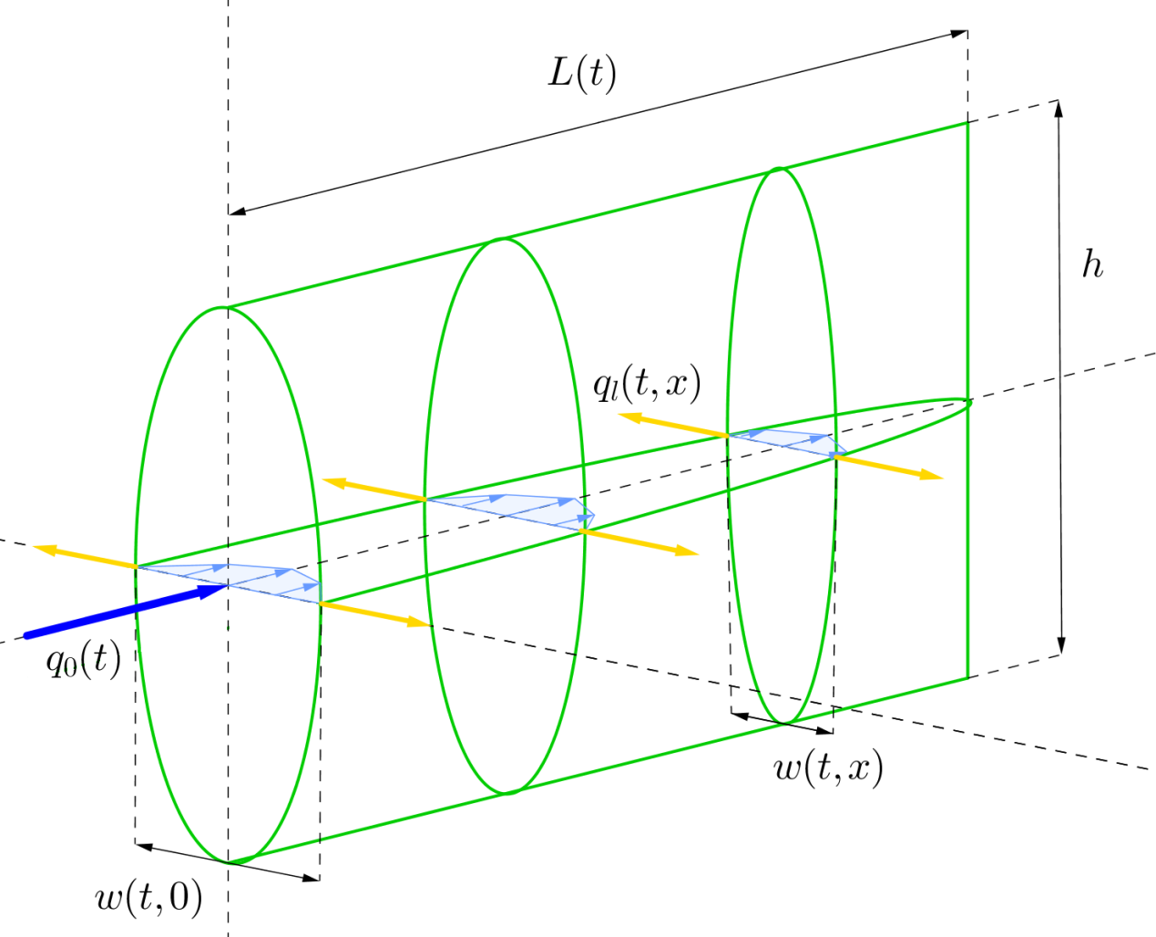
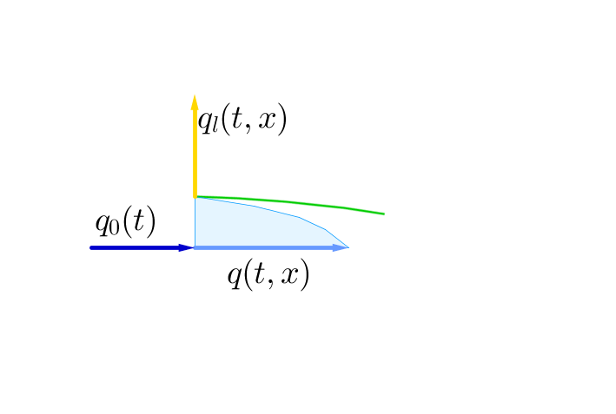
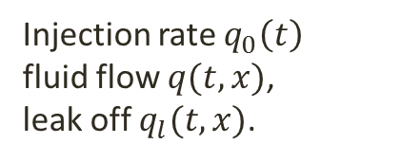
PKN model geometry
Named after Perkins, Kern and Nordgren
fracture length
constant fracture
height
Injection rate $q_{0}\left(t\right)$
fluid flow $q(t,x)$,
leak off $q_{l}(t,x)$.
crack width

Slide 5
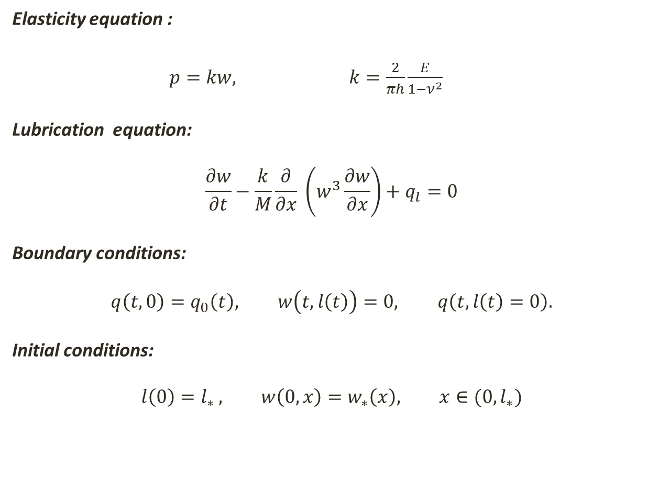
PKN problem formulation
Elasticity equation :
$p=kw,$ $k=\frac{2}{πh}\frac{E}{1−ν^{2}}$
Lubrication equation:
$$\frac{∂w}{∂t}−\frac{k}{M}\frac{∂}{∂x} \left(w^{3}\frac{∂w}{∂x}\right)+q_{l}=0$$
Boundary conditions:
$$q\left(t,0\right)=q_{0}\left(t\right), w\left(t,l\left(t\right)\right)=0, q\left(t,l\left(t\right)=0\right).$$
Initial conditions:
$$l\left(0\right)=l_{∗ }, w\left(0,x\right)=w_{∗}\left(x\right), x∈(0,l_{∗})$$
net pressure
Moving boundary (crack tip)

Slide 6
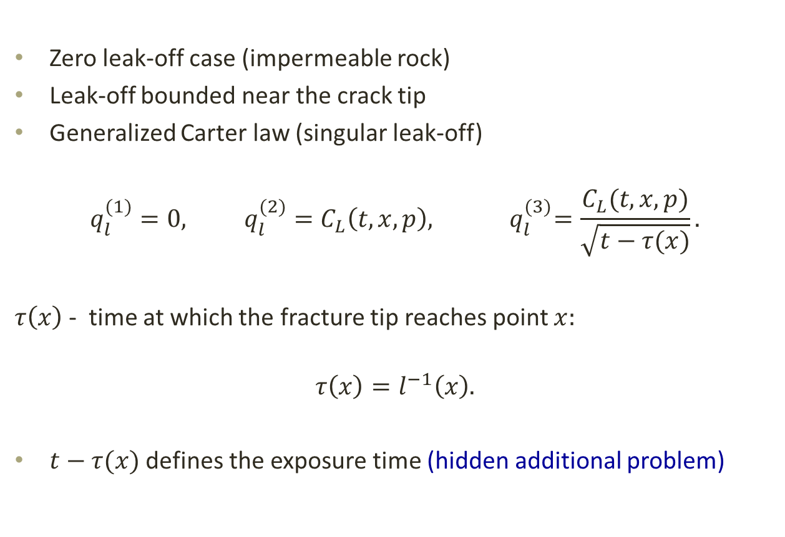
Leak-off regimes
Zero leak-off case (impermeable rock)
Leak-off bounded near the crack tip
Generalized Carter law (singular leak-off)
$$q_{l}^{(1)}=0, q_{l}^{(2)}=C_{L}\left(t,x,p\right),{ q}_{l}^{(3)}=\frac{C_{L}(t,x,p)}{\sqrt{t−τ(x)}}.$$
$τ\left(x\right)$ - time at which the fracture tip reaches point $x:$
$$τ\left(x\right)=l^{−1}\left(x\right).$$
$t−τ(x)$ defines the exposure time (hidden additional problem)
Notes:
Explain: 1D model used to simulate the whole 3D phenomena.

Slide 7
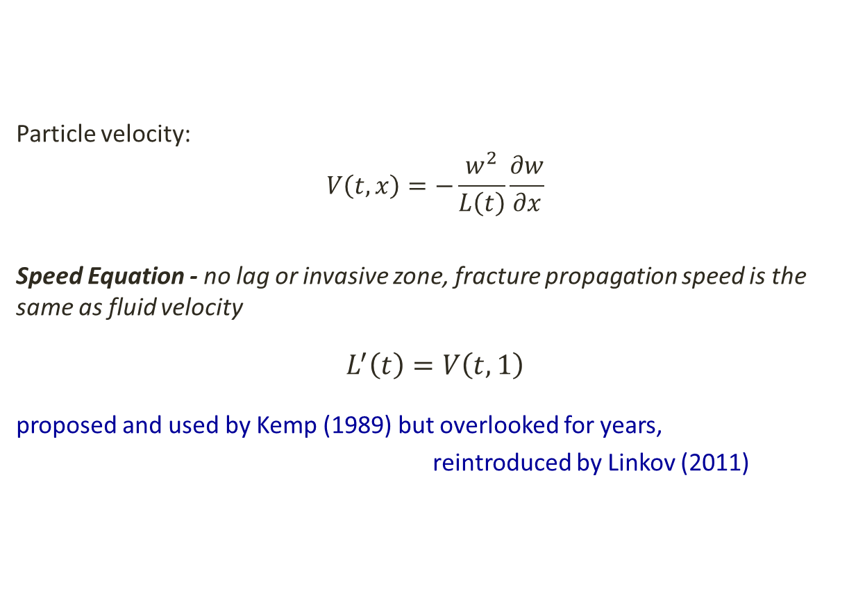
Speed Equation
Particle velocity:
$$V\left(t,x\right)=−\frac{w^{2}}{L\left(t\right)}\frac{∂w}{∂x}$$
Speed Equation - no lag or invasive zone, fracture propagation speed is the same as fluid velocity
$$L^{′}\left(t\right)=V\left(t,1\right)$$
proposed and used by Kemp (1989) but overlooked for years,
reintroduced by Linkov (2011)

Slide 8
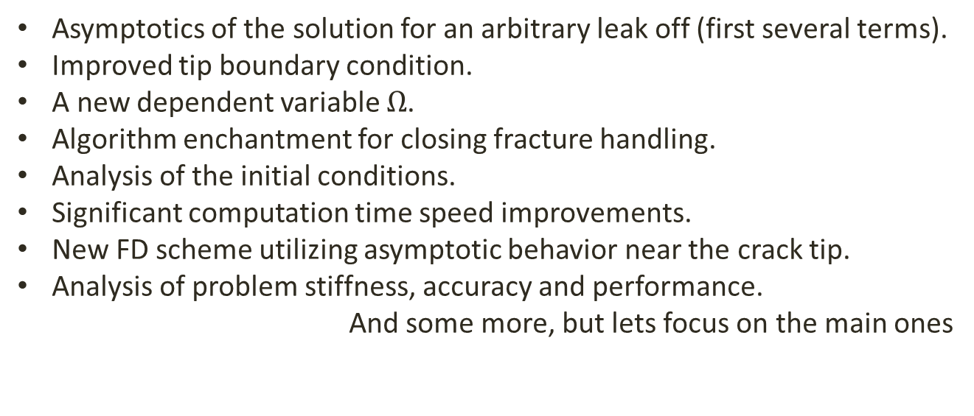
My contributions to PKN model
Asymptotics of the solution for an arbitrary leak off (first several terms).
Improved tip boundary condition.
A new dependent variable $Ω$.
Algorithm enchantment for closing fracture handling.
Analysis of the initial conditions.
Significant computation time speed improvements.
New FD scheme utilizing asymptotic behavior near the crack tip.
Analysis of problem stiffness, accuracy and performance.
And some more, but lets focus on the main ones

Slide 9
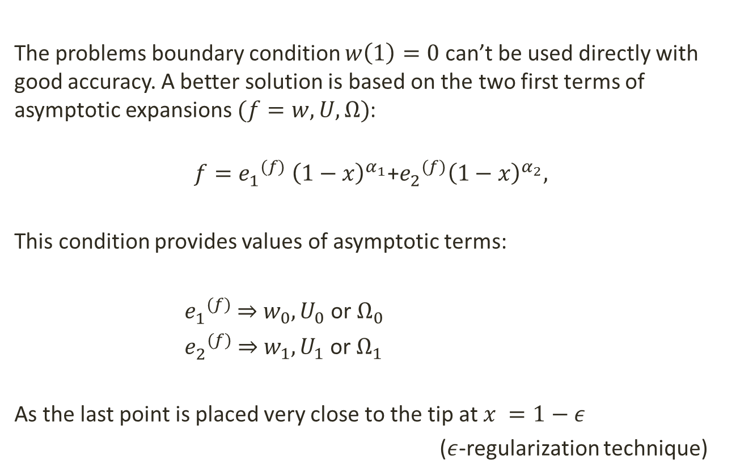
Two term boundary condition
The problems boundary condition $w\left(1\right)=0$ can’t be used directly with good accuracy. A better solution is based on the two first terms of asymptotic expansions $(f=w,U,Ω)$:
$$f={e_{1}^{}}^{(f)} {\left(1−x\right)}^{α_{1}}\text{+}{e_{2}^{}}^{(f)}{\left(1−x\right)}^{α_{2}},$$
This condition provides values of asymptotic terms:
${e_{1}^{}}^{(f)}$ ⇒ $w_{0},U_{0}$ or $Ω_{0}$
${e_{2}^{}}^{(f)}$ ⇒ $w_{1},U_{1}$ or $Ω_{1}$
As the last point is placed very close to the tip at $x =1−ε$
($ε$-regularization technique)
Notes:
Narysować szczelinę, degeneretive tip i wyjaśnić że to co się dzieje w wierzchołku zależnie od wartości pochodnej na duży wpływ na całą szczelinę-stiffnes source

Slide 10
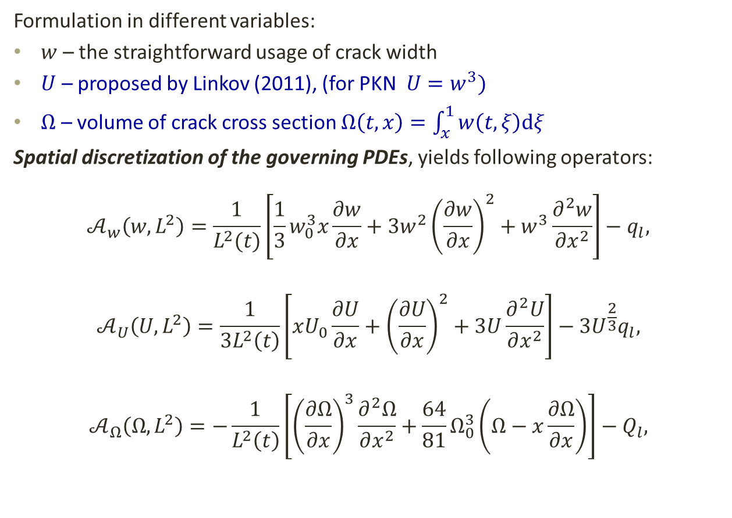
Dynamic systems
Formulation in different variables:
$w$ – the straightforward usage of crack width
$U$ – proposed by Linkov (2011), (for PKN $U=w^{3})$
$Ω$ – volume of crack cross section $Ω\left(t,x\right)=\int_{x}^{1}{w\left(t,ξ\right)dξ}$
Spatial discretization of the governing PDEs, yields following operators:
$$𝒜_{w}\left(w,L^{2}\right)=\frac{1}{L^{2}(t)}\left[\frac{1}{3}w_{0}^{3}x\frac{∂w}{∂x}+3w^{2}{\left(\frac{∂w}{∂x}\right)}^{2}+w^{3}\frac{∂^{2}w}{∂x^{2}}\right]−q_{l},$$
$$𝒜_{U}\left(U,L^{2}\right)=\frac{1}{3L^{2}\left(t\right)}\left[xU_{0}\frac{∂U}{∂x}+{\left(\frac{∂U}{∂x}\right)}^{2}+3U\frac{∂^{2}U}{∂x^{2}}\right]−3U^{\frac{2}{3}}q_{l},$$
$$𝒜_{Ω}\left(Ω,L^{2}\right)=−\frac{1}{L^{2}\left(t\right)}\left[{\left(\frac{∂Ω}{∂x}\right)}^{3}\frac{∂^{2}Ω}{∂x^{2}}+\frac{64}{81}Ω_{0}^{3}\left(Ω−x\frac{∂Ω}{∂x}\right)\right]−Q_{l},$$
proper variables

Slide 11
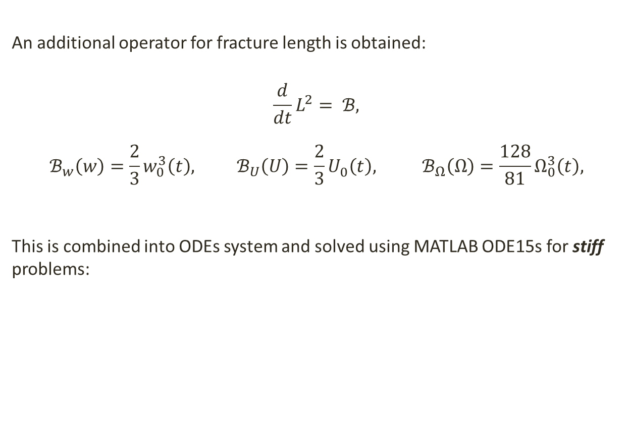
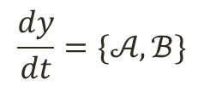
Dynamic Systems
An additional operator for fracture length is obtained:
$$\frac{d}{dt}L^{2}= ℬ,$$
$$ℬ_{w}\left(w\right)=\frac{2}{3}w_{0}^{3}\left(t\right), ℬ_{U}\left(U\right)=\frac{2}{3}U_{0}^{}\left(t\right), ℬ_{Ω}\left(Ω\right)=\frac{128}{81}Ω_{0}^{3}\left(t\right),$$
This is combined into ODEs system and solved using MATLAB ODE15s for stiff problems:
$$\frac{dy}{dt}=\{𝒜,ℬ\}$$

Slide 12
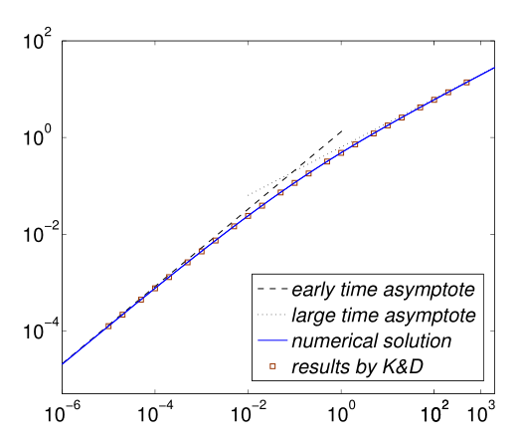
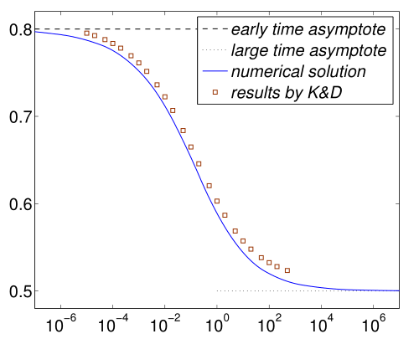
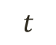
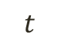
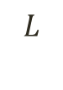
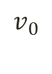
Dynamic Systems
So far this allows solving simple 1D hydrofracturing problems. Although this problems were solved before, my solution offers better accuracy and is one of the very first to use speed equation with finite difference formulation.
However more problems must to be solved to obtain truly rebuts and accurate procedure…
$$L$$
$$v_{0}$$
$$t$$
$$t$$

Slide 13
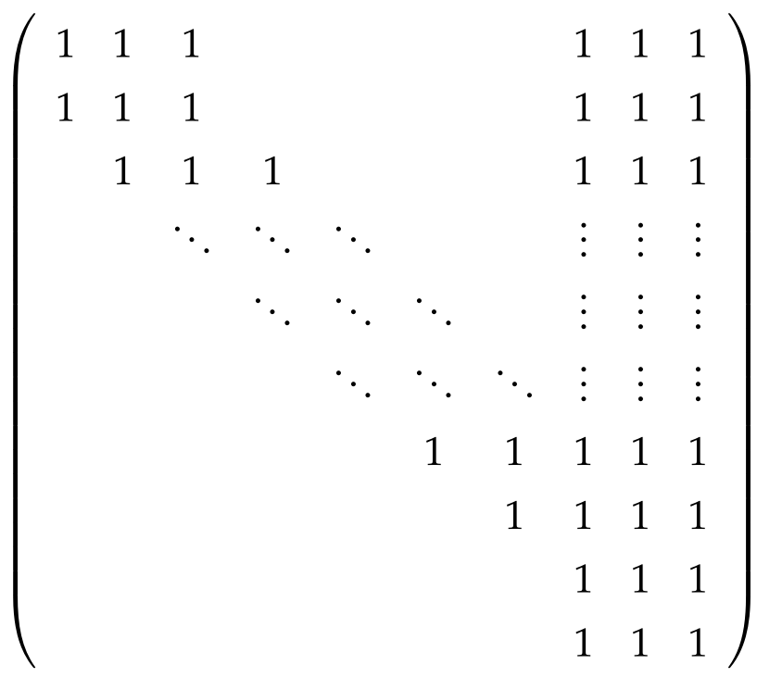
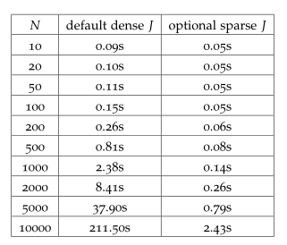
Speeding up computation time
The time needed to solve PKN problem with ODE solvers can vary drastically. The most noticeable speedup is achieved by proper sparse Jacobian utilization:

Slide 14
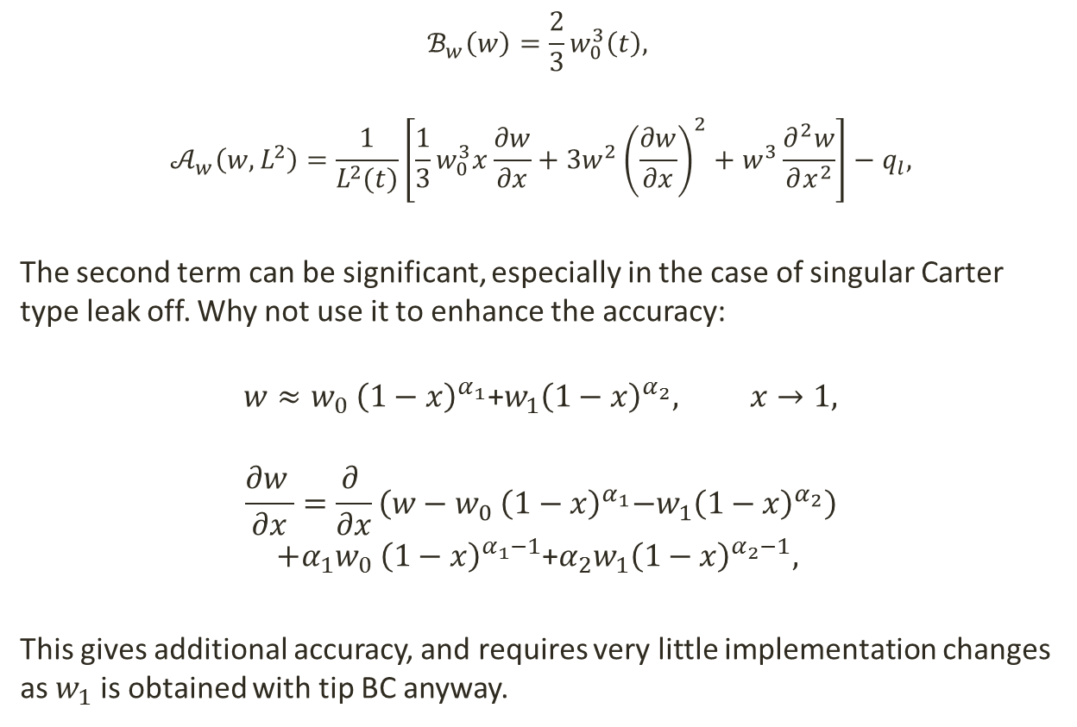
New FD scheme based on asymptotic behavior near the crack tip.
$$ℬ_{w}\left(w\right)=\frac{2}{3}w_{0}^{3}\left(t\right),$$
$$𝒜_{w}\left(w,L^{2}\right)=\frac{1}{L^{2}(t)}\left[\frac{1}{3}w_{0}^{3}x\frac{∂w}{∂x}+3w^{2}{\left(\frac{∂w}{∂x}\right)}^{2}+w^{3}\frac{∂^{2}w}{∂x^{2}}\right]−q_{l},$$
The second term can be significant, especially in the case of singular Carter type leak off. Why not use it to enhance the accuracy:
$$w≈w_{0} {\left(1−x\right)}^{α_{1}}\text{+}w_{1}{\left(1−x\right)}^{α_{2}}, x→1,$$
$$\frac{∂w }{∂x}=\frac{∂ }{∂x}\left(w−w_{0} {\left(1−x\right)}^{α_{1}}\text{−}w_{1}{\left(1−x\right)}^{α_{2}}\right)$$
$$+{α_{1}w}_{0} {\left(1−x\right)}^{α_{1}−1}\text{+}{α_{2}w}_{1}{\left(1−x\right)}^{α_{2}−1},$$
This gives additional accuracy, and requires very little implementation changes as $w_{1}$ is obtained with tip BC anyway.
Notes:
It helps to smooth (remove the steepest part) the function before applying standard central FD, which is not very accurate for functions like (1-x)^alpha

Slide 15
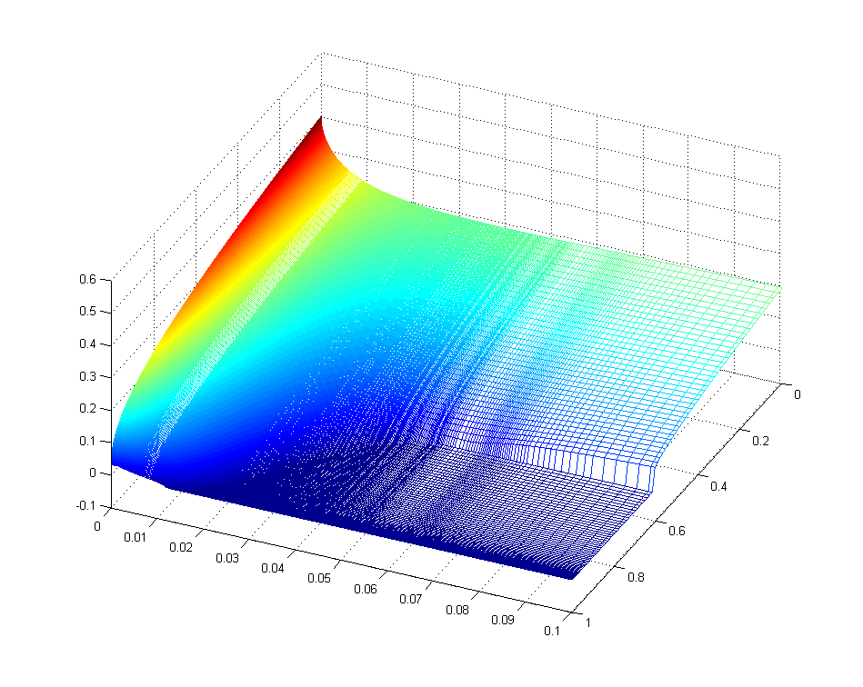
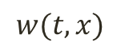
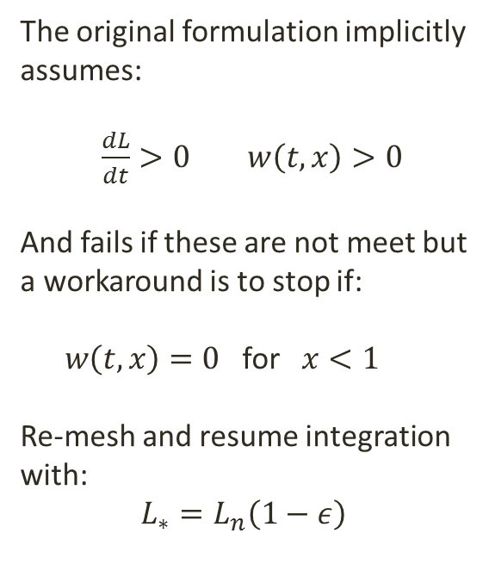
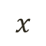
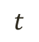
Handling closing fractures, large leak off values
The original formulation implicitly assumes:
$\frac{dL}{dt}>0 w\left(t,x\right)>0$
And fails if these are not meet but a workaround is to stop if:
$w\left(t,x\right)=0$ for $x<1$
Re-mesh and resume integration with:
$L_{∗}=L_{n}\left(1−ε\right)$
$$w(t,x)$$
$$x$$
$$t$$

Slide 16
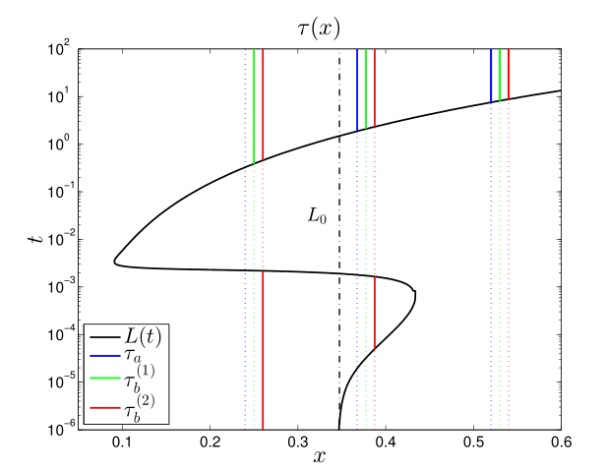
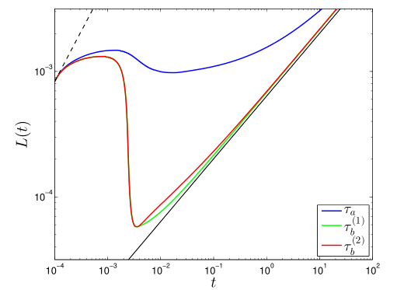
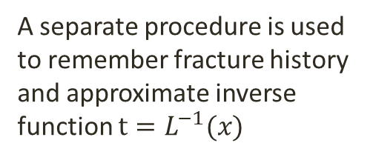
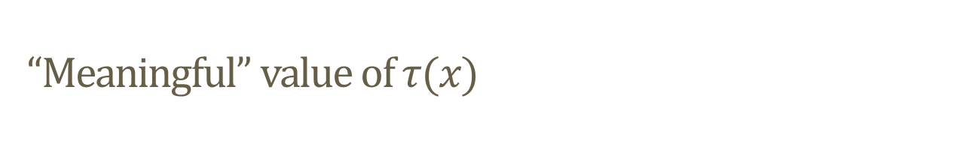
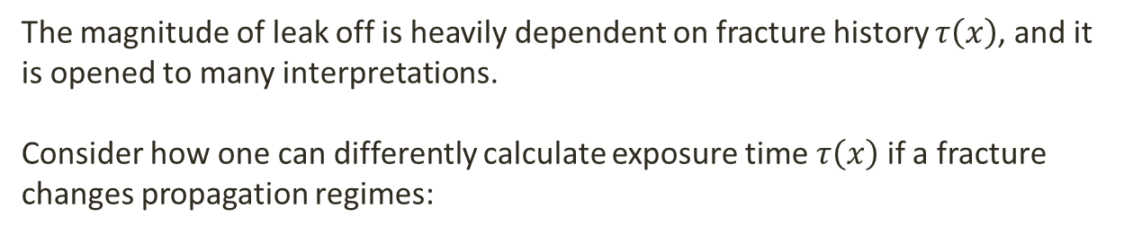
“Meaningful” value of $τ(x)$
The magnitude of leak off is heavily dependent on fracture history $τ\left(x\right)$, and it is opened to many interpretations.
Consider how one can differently calculate exposure time $τ\left(x\right)$ if a fracture changes propagation regimes:
A separate procedure is used to remember fracture history and approximate inverse function $t=L^{−1}(x)$
(it is far from perfect but at least attempts to use the previously ignored information)
Notes:
Note that q_0 and C_L are constant in this example !!!!

Slide 17
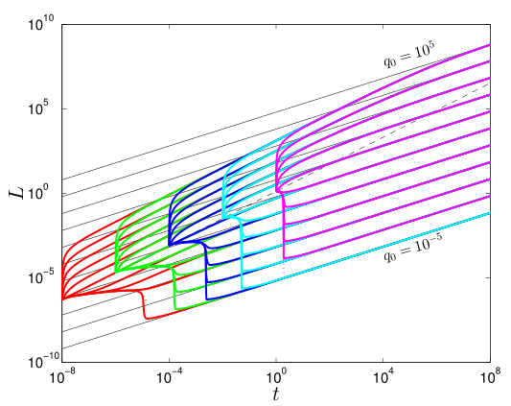
Testing against various initial conditions
With all of the aforementioned improvements it is possible to test multitudes of various initial condition combinations within reasonable time limit and predictable accuracy.

Slide 18
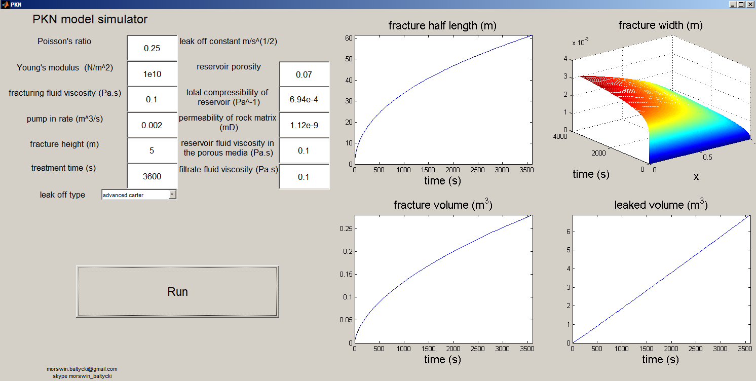
Final result for single PKN fracture
Simple interface for running simulations, based on the improved algorithms.

Slide 19
On to Multifracturing
Main issues and challenges
Multiple elements to be specified and combined (cracks, pipes and their connections)
Dealing with junction points and fluid redistribution
Crack collisions
Crack interactions (backstress)
Other programing challenges

Slide 20
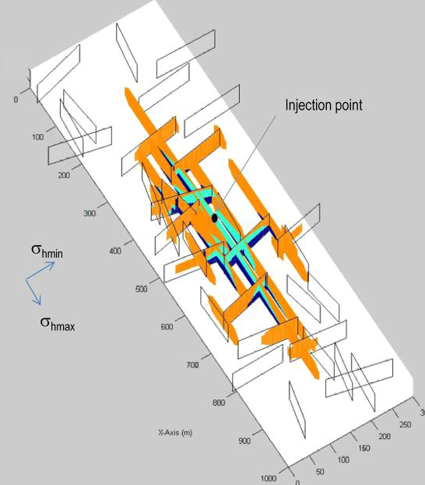
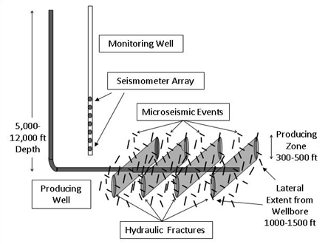
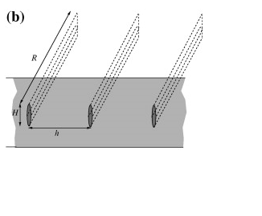
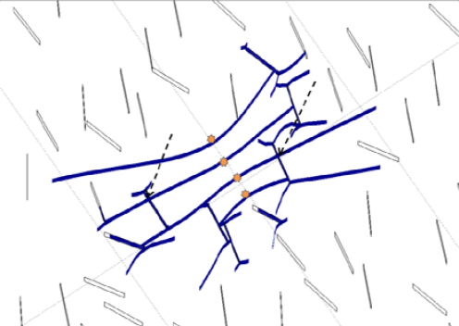
What is “Multifracturing” ?
Weng(2011)
all this work is fresh
none is complete
none is free (no source code and or details available)
none of these is based on the speed equation
Bunger(2013)
Kresse(2013)

Slide 21
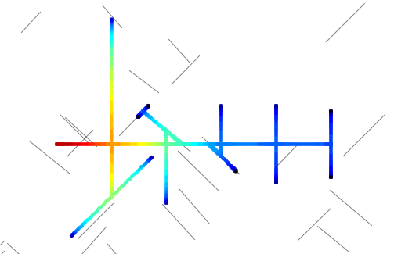
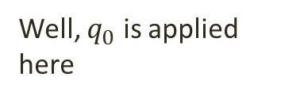
What do I mean by “Multifracturing”
Well, $q_{0}$ is applied here
existing closed crack
PKN like crack
Solid concrete pipe
PKN like “pipe”
Junction
All of these features are to be integrated together in a versatile package,
that can simulate various different scenarios.

Slide 22
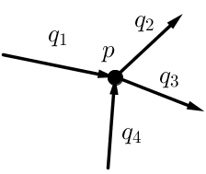
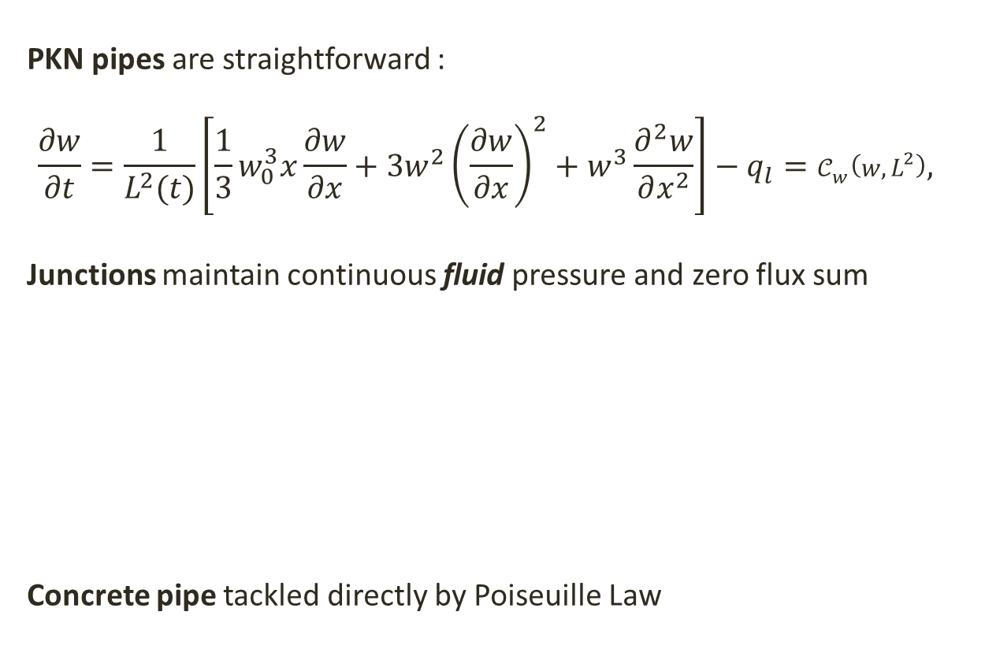
PKN “Pipe” , Junctions and Concrete pipes
PKN pipes are straightforward :
$$\frac{∂w}{∂t}=\frac{1}{L^{2}(t)}\left[\frac{1}{3}w_{0}^{3}x\frac{∂w}{∂x}+3w^{2}{\left(\frac{∂w}{∂x}\right)}^{2}+w^{3}\frac{∂^{2}w}{∂x^{2}}\right]−q_{l}=𝒞_{w}\left(w,L^{2}\right),$$
Junctions maintain continuous fluid pressure and zero flux sum
Concrete pipe tackled directly by Poiseuille Law

Slide 23
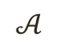
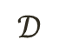
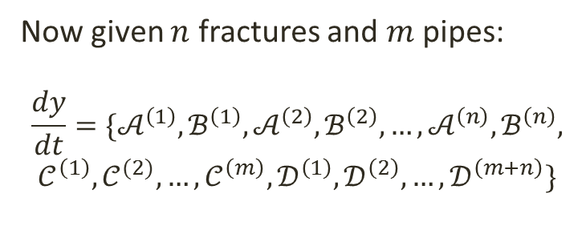
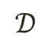
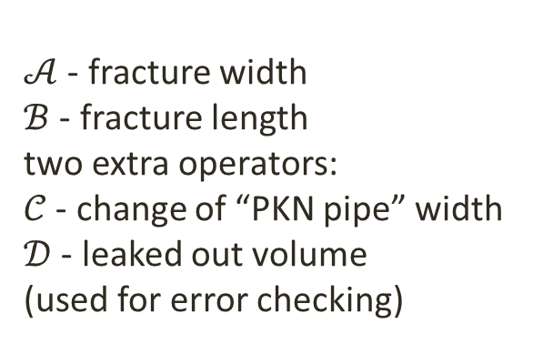
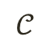
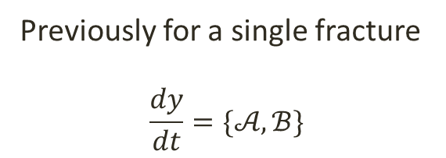
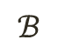
How to make it stick together ?
$𝒜$ - fracture width
$ℬ$ - fracture length
two extra operators:
$𝒞$ - change of “PKN pipe” width
$𝒟$ - leaked out volume
(used for error checking)
$$ℬ$$
$$𝒜$$
$$𝒟$$
$$𝒞$$
$$𝒟$$
Previously for a single fracture
$$\frac{dy}{dt}=\{𝒜,ℬ\}$$
Now given $n$ fractures and $m$ pipes:
$$\frac{dy}{dt}=\{𝒜^{\left(1\right)},ℬ^{\left(1\right)},𝒜^{\left(2\right)},ℬ^{\left(2\right)},…,𝒜^{\left(n\right)},ℬ^{\left(n\right)},$$
$$𝒞^{\left(1\right)},𝒞^{(2)},…,𝒞^{\left(m\right)}, 𝒟^{\left(1\right)},𝒟^{\left(2\right)},…,𝒟^{\left(m+n\right)}\}$$
Thus a large coupled system is constructed

Slide 24
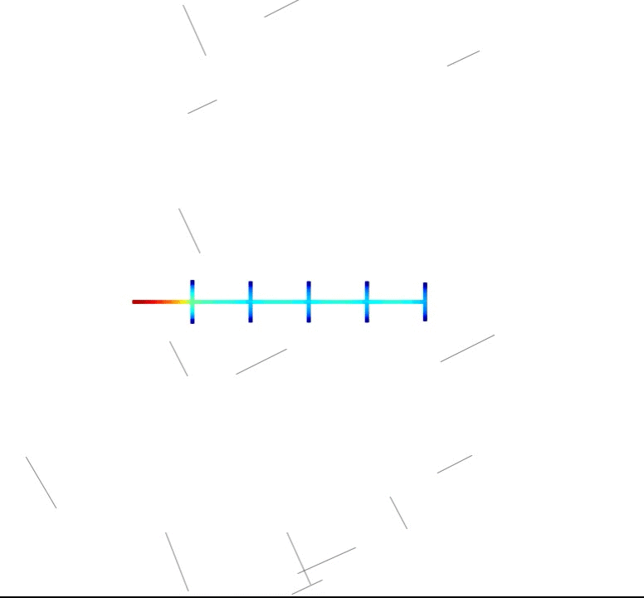
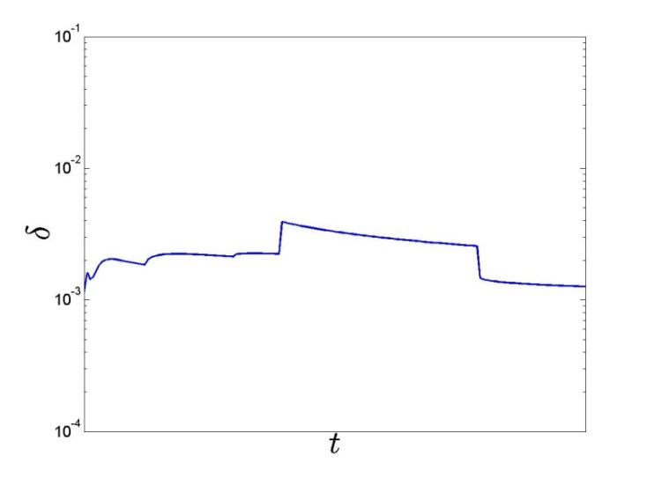

Crack collisions and splits
Requirements:
Fluid balance must remain stable
Extrapolation of new grid points
Adjustment of newly created areas
to create plausible initial conditions
Model stops integration, re-meshes and then resumes.
The goal is to be able to continue computations from every possible scenario, rather than simulate the physical process exactly.
relative fluid balance still stable around ${10}^{−3}$

Slide 25


Backstress fracture interactions
Originally $p$ was the net fluid pressure:
$p_{net}=p_{fluid}−σ_{0}$ $−σ_{l}$
Where $σ_{0}$ is the uniform backstress.
An additional term $σ_{l}$ , the stress from other neighboring fractures should also be considered:
$$𝒜_{w}\left(w,L^{2}\right)=\frac{k}{{ML}^{2}(t)}\left[\frac{1}{3}w_{0}^{3}x\frac{∂w}{∂x}+3w^{2}{\left(\frac{∂w}{∂x}\right)}^{2}+w^{3}\frac{∂^{2}w}{∂x^{2}}\right]$$
$$−\frac{1}{ML^{2}\left(t\right)}\left(3w^{2}\frac{∂w}{∂x}\frac{∂σ_{l}}{∂x}+w^{3}\frac{∂^{2}σ_{l}}{∂x^{2}}\right) −q_{l},$$
How to find $σ_{l}$ ? (nothing like this in the original PKN model)

Slide 26




How we find $σ_{l}$ ?
Approximations for far field and close parallel influence were derived by Bunger (2013), which in PKN case can be interpreted as:
$σ_{l}^{(1)}=\frac{3}{8}p\frac{H_{m}^{2}}{h_{m}^{2}}$
$σ_{l}^{(2)}=\frac{L\int_{0}^{1}{w dx}}{h_{m}^{3}}$
Simplified generalized scheme can be used:
$σ_{l}^{(j)}=\frac{gkw_{j}Δx_{j}L_{j}}{d^{3}}\left(\hat{n_{j}}⋅\hat{σ}\right)⋅\left(\hat{n_{i}}⋅\hat{σ}\right)$

Slide 27



How to find $σ_{l}$ ? 2D visibility problem
Fracture neighbors must be found. This is quite complex calculation, an existing algorithm is adopted.
For every grid point:
casts rays to each vertex
sorts these vertexes by ray angles
maps connected edges to interval $θ∈\left(0,2π\right)$
the closest edge in each interval is the visible one
The cost for one grid point is only $O\left(v\log{v}\right)$
(depends on the number of vertexes)

Slide 28


Other programing challenges
The implementation used to obtain multifracturing results:
written in Java with some parts in C
follows OO principles
still work in progress…

Slide 29
Conclusions
Thorough analysis of PKN model was done for any possible leak offs
Fast and accurate PKN solvers were built and extensively tested
Various dependent variables, boundary conditions and discretization's were considered.
Closing fractures can be modeled.
The most efficient approaches to the single fracture problem were used for multifracturing problem with natural fractures.
Fracture interactions, both collisions and stress related were introduced, which should reassemble the real ones.
Dramatic speed up in computation time can be achieved through some elegant optimization.
Developing such a piece of software is at least as challenging and time consuming as the mathematical formulation.
Wide range of scenarios can be tackled, various future case studies could be done, and answers to real life questions could be obtained.
The developed multifracturing solver (once finally ready) should be released for free usage.
The End

Slide 30




Jacobian Pattern
FD discretization
+ joint conditions
+ backstress interactions

Slide 31









Speeding up computations
Recent publications call for better CPU performance, so consider these two ideas:
Work on several orders of magnitude smaller $m$ by $m$ matrix for fracture interactions
Parallelize code, one thread per each fracture.
$m$ by $m$
18 entries
$mN$ by $mN$
40832 entries
100 times faster !!!

Slide 32


Collision models
Dimitry Chuprakov, Olga Melchaeva and
Romain Prioul
“Hydraulic Fracture Propagation Across a Weak Discontinuity Controlled by Fluid Injection”

Slide 33






How to test if the produced results are valid ?
Split benchmark into pipe and crack segment
Try simple geometries
Check the total fluid balance
$$\int_{0}^{L}{(w}−w_{∗})dx −\int_{0}^{L}{q_{0} dx}+\int_{0}^{L}{\int_{0}^{t}{q_{l} dtdx}=0}$$
$$q_{0}$$
$$−q_{0}$$

Slide 34



Interesting fracturing scenarios
Now consider this coupled array with neighboring fracture influence enabled

Slide 35


A little on technical implementation details
Java
Object Oriented
Abstract interface to integration codes (ODE15s, LSODE, GNU GSL, …)
Changeable depended variables
No restrictions on
model size and
geometry.
Note that this is actually a graph.
(very helpful abstraction)

Slide 36







Handling closing fractures, negative pumping
$$q_{0}=α+\sin\left(t\right)$$
with 0 < $α<1$
Total volume pumped in
$$x$$
$$t$$
$${10}^{−3}$$
It works!
Control: Fluid balance in fracture

Slide 37





Handling closing fractures, negative pumping
$q_{0}=\sin\left(t\right)$
Total volume pumped in
$$x$$
$$t$$
At some point everything goes wrong…
Fluid balance in fracture

